Slide 1
Image Representation
Course Code: CSC 3224
Course Title: Computer Graphics
Dept. of Computer Science
Faculty of Science and Technology
Lecturer No: | 01 | Week No: | 1 | Semester: | Spring 2024-2025
Lecturer:

Slide 2
Outline
Pixel
Graphics Image
Formation of Raster Image
Formation of Vector Image
Color Model
Color Representation Techniques
Printing
Image Files
Books
References

Slide 3
Pixel
A pixel (short for "picture element") is the smallest unit of a digital image that contains color and intensity information
The pixels are arranged in a grid-like structure where the total number of pixels is a function of the size of the image and the number of pixels per unit length (e.g. inch) in the horizontal as well as the vertical direction
The total number of pixels in an image refers to resolution where the quality is improved when more pixels are added.
Image size given as the total number of pixels in the horizontal direction times the total number of pixels in the vertical direction might vary due to Pixels Per Inch (PPI)
An image is formed when the pixels when a grid is formed by setting pixels composing of coordinates and color information. The collective effects of the pixels taking on different color attributes give us what we see as a picture

Slide 4
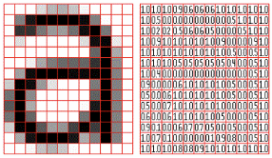
Pixel (Cont.)
Fig-1 (a): Image
Fig-1 (b): Pixel Representation

Slide 5
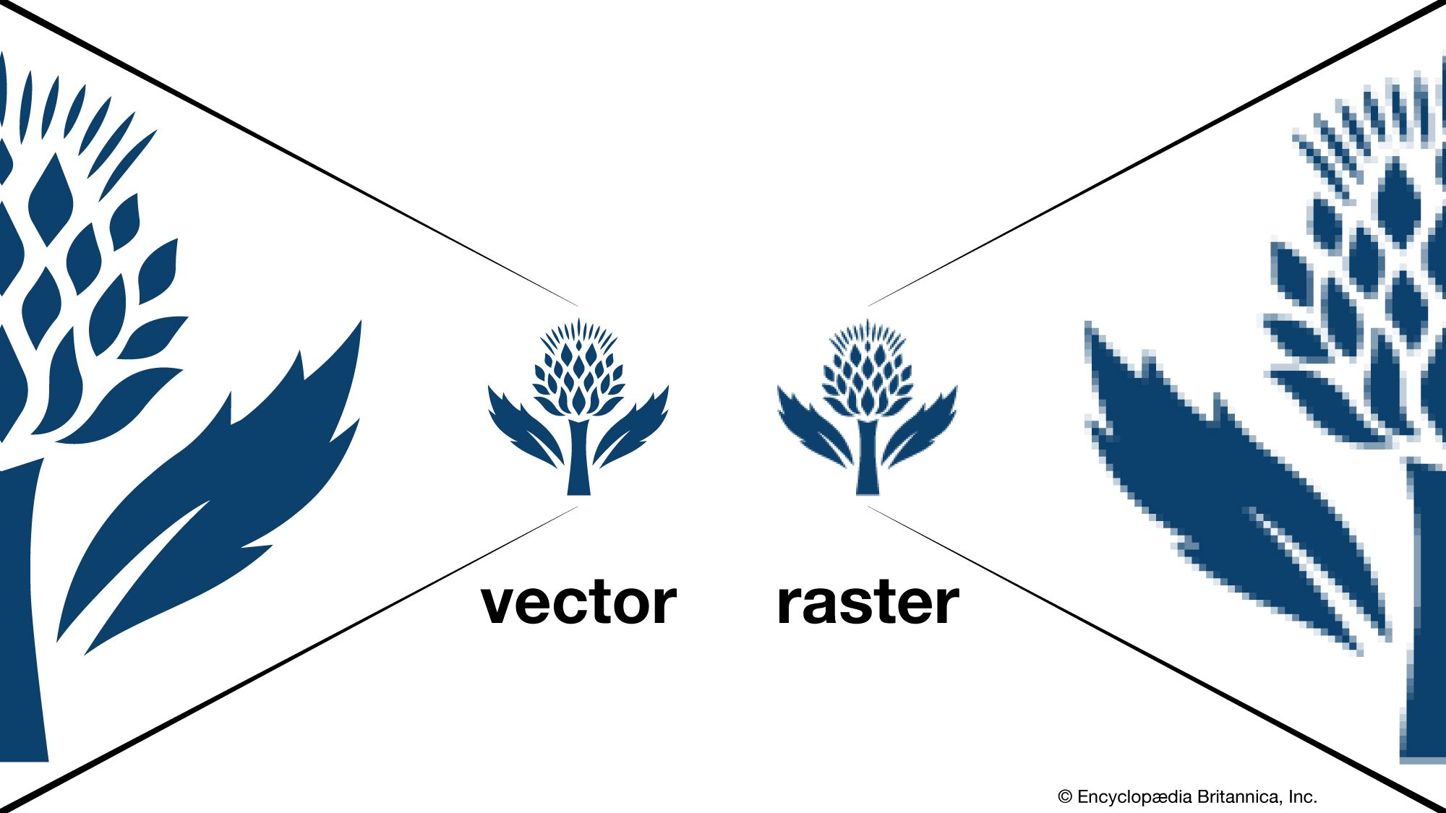
Graphics Images
There are two types of graphics image:
Raster Image
Vector Image
Fig-2: Graphics Images

Slide 6
Raster Image
Composed of individual pixels arranged in a grid. This gives the name Bitmap structure.
Each pixel has a fixed color value.
Resolution-dependent: Scaling up results in pixelation.
Best for photographs and detailed images.
Common file formats: JPEG, PNG, GIF, BMP, TIFF.
Examples: Digital photos, Scanned images, Screenshots

Slide 7
Vector Image
Made up of mathematical equations instead of pixels. Each pixel has a fixed color value.
Resolution-independent: Can be scaled infinitely without losing quality.
Best for logos, illustrations, and text-based graphics.
Common file formats: SVG, AI, EPS, PDF.
Example: Company logos, Icons, Infographics

Slide 8
Formation of Raster Image
1. Grid Structure:
A raster image is made up of a grid of rows and columns filled with pixels.
Each pixel acts like a small tile in a mosaic.
2. Color Information (RGB Model):
Each pixel is assigned a color based on the RGB (Red, Green, Blue) model.
The intensity of each color ranges from 0 to 255, allowing for millions of color combinations.

Slide 9
Formation of Raster Image(Cont.)
3. Resolution and Detail:
The number of pixels in the image determines its resolution (e.g., 1920 × 1080 pixels).
Higher resolution = more pixels = sharper image.
Lower resolution = fewer pixels = blocky or pixelated image when enlarged.
4. How It Displays on a Screen:
When displayed on a monitor, each pixel lights up in its assigned color.
The human eye blends these pixels together, forming a smooth image.

Slide 10
Formation of Vector Image
1. Mathematical Equations:
A vector image is made up of points (nodes), lines, and curves.
These elements are connected using mathematical formulas to create shapes.
2. Scalable and Resolution-Independent:
Since the image is based on formulas, it can be scaled up or down without losing quality.
Unlike raster images, it doesn’t get pixelated when enlarged.

Slide 11
Formation of Vector Image (Cont.)
3. Color and Fill:
Each shape in a vector image can be assigned colors, gradients, or patterns.
The image remains sharp and clear at any size.
4. How It Displays on a Screen:
Rasterization (Vector to raster)
Mapped with display pixel coordinate.

Slide 12
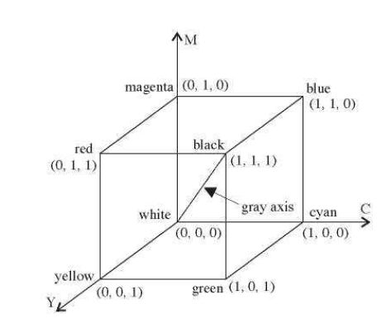
Color Model
Color models are ways of representing colors in digital images. They define how colors are created and stored in a computer. The most common color models are RGB and CMYK. The range of possible colors are represented through color space.
Fig-3 (a): RGB Color Space
Fig-3 (b): CMY Color Space

Slide 13
RGB Color Model
Fig-3(a) shows coordinate system with three primary colors: R (red), G (green), and B (blue) where each primary color can take on an intensity value ranging from 0 (off—lowest) to 1 (on—highest).
Mixing these three primary colors at different intensity levels produces a variety of colors which is an Additive Process.
The collection of all the colors obtainable by such a linear combination of red, green, and blue forms the cube-shaped RGB color space Fig:3(a).
For RGB color model an arbitrary color within the cubic color space can be specified by its color coordinates: (r, g, b). For example, we have (0,0,0) for black, (1,1,1) for white, (1,1,0) for yellow, etc. A gray color at (0.7,0.7,0.7) has an intensity halfway between one at (0.9,0.9,0.9) and one at (0.5,0.5,0.5).
Color specification using the RGB model is an additive process. We begin with black and add on the appropriate primary components to yield a desired color.

Slide 14
CMY Color Model
CMY color model, that defines colors using a subtractive process and it is complementary to RGB Color model
In the CMY model we begin with white and take away the appropriate primary components to yield a desired color. For example, if we subtract red from white, what remains consists of green and blue, which is cyan.
Fig-3(b) shows a coordinate system using the three primaries' complementary colors: C (cyan), M (magenta), and Y (yellow)
Fig-4: Conversion between the two color models

Slide 15
RGB to CMY
C = 1 –( color.R / 255.0);
M = 1 – (color.G / 255.0);
Y = 1 – (color.B / 255.0);

Slide 16
CMY To RGB
R = (1 - C) * 255.0,
G = (1 - M) * 255.0,
B = (1 - Y) * 255.0

Slide 17
Color Representation Techniques
In digital image processing different methods of storing and accessing pixel color information. Two common methods are: Direct coding and Lookup Tables (LUTs)
Direct Coding:
Using direct coding we allocate a certain amount of storage space for each pixel to code its color.
We may allocate 3 bits for each pixel, with one bit for each primary color
This 3-bit representation allows each primary to vary independently between two intensity levels: 0 (off) or 1 (on).
Hence each pixel can take on one of the eight colors that correspond to the corners of the RGB color cube.

Slide 18
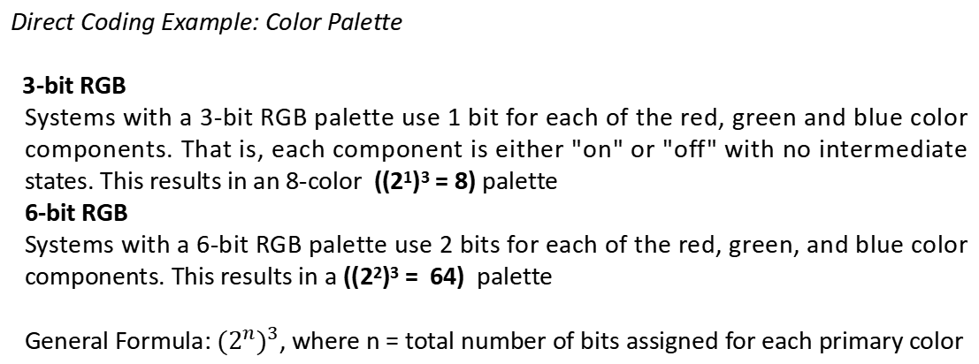
Color Representation Techniques (Cont.)
Direct Coding Example: Color Palette
3-bit RGB
Systems with a 3-bit RGB palette use 1 bit for each of the red, green and blue color components. That is, each component is either "on" or "off" with no intermediate states. This results in an 8-color ((2¹)³ = 8) palette
6-bit RGB
Systems with a 6-bit RGB palette use 2 bits for each of the red, green, and blue color components. This results in a ((2²)³ = 64) palette
General Formula: ${(2^{n})}^{3}$, where n = total number of bits assigned for each primary color

Slide 19
Color Representation Techniques (Cont.)
LookUp Table
In this approach pixel values do not code colors directly. Instead, they are addresses or indices into a table of color values.
The color of a particular pixel is determined by the color value in the table entry that the value of the pixel references.
Fig-5: Lookup table

Slide 20
Printing
A printer deposits color pigments onto a print media, changing the light reflected from its surface and making it possible for us to see the print result.
Given the fact that the most commonly used print media is a piece of white paper, we can in principle utilize three types of pigments (cyan, magenta, and yellow) to regulate the amount of red, green, and blue light reflected to yield all RGB colors
While some printing methods allow color pigments to blend together, in many cases the various color pigments remain separate in the form of tiny dots on the print media.
Halftone is a technique used to create the illusion of shades and gradients using only dots of varying sizes and spacing. It is commonly used in printing, newspapers, and comic books to represent images with limited colors.

Slide 21
Halftone Image
A halftone, or halftone image, is an image comprised of discrete dots rather than continuous tones. When viewed from a distance, the dots blur together, creating the illusion of continuous lines and shapes.
These dots are arranged in a pattern that forms a 45° screen angle with the horizon
The size of the dots is inversely proportional to the intended intensity level

Slide 22
Halftone
Halftone is the technique that simulates continuous tone imagery through the use of dots.
Dots can be varied either
in size
in shape or
in spacing
Halftone generates a gradient like effect.

